Slide 1

DEPARTMENT OF ARTIFICIAL INTELLIGENCE AND DATA SCIENCE
Project name : Smart Water Management
Team name :
Team members :
KISHAN KANTH DS(113321104302)
GOWTHAMCHANDRAN J(113321104301)
YUVARAJ K(113321104120)

Slide 2
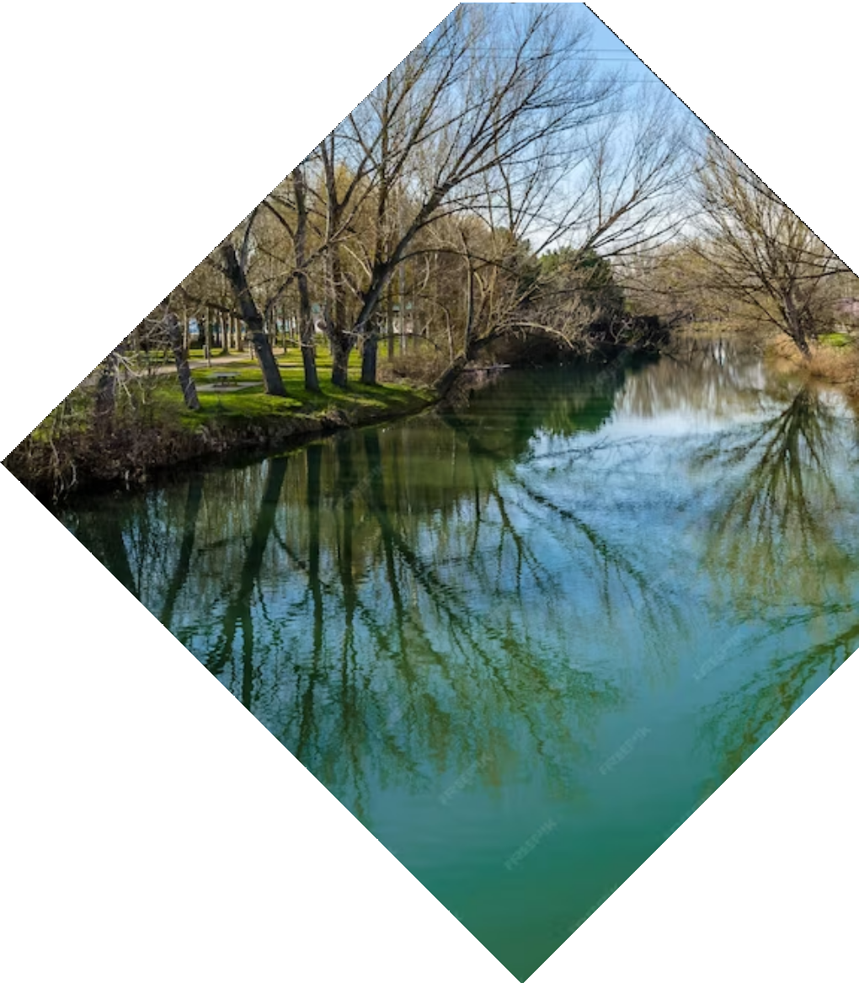

Smart Water Management

Slide 3

Abstract
"An innovative Smart Water Management System optimizes resource allocation, monitors consumption, and minimizes waste, fostering sustainable water usage through advanced technology and data-driven decision-making."

Slide 4


Problem statement
"The escalating global water crisis demands a Smart Water Management System to efficiently track and conserve water resources, reduce wastage, and ensure equitable distribution, necessitating innovative technological solutions."

Slide 5

Exsisting system
"Existing smart water management systems encompass IoT sensors, real-time data analytics, and remote monitoring to detect leaks, manage supply networks, and optimize water distribution. Examples include WaterSCADA, Ayyeka's Wavelet, and Iota's Tangle-based solutions, enhancing water resource efficiency and sustainability."

Slide 6

proposed system
"A proposed Smart Water Management System integrates IoT sensors, machine learning algorithms, and blockchain technology to enable real-time monitoring, automated leak detection, equitable distribution, and transparent billing, ensuring sustainable water resource management, reduced wastage, and improved service quality."

Slide 7

Software requirement
Hardware (Sensors and Sensors Adapters)
a. Data acquisition and monitoring
b. Data conversion and transmission
2. Water Information System (Big Water Data Management and Analysis)
a. Data processing and Storage
3. Software (Support Services and Applications)
a. Modelling and analytics
b. Real-Time Monitoring and Control System
c. Decision Support System and Visualization
d. Dissemination of information to stakeholders

Slide 8
Hardware requirement
Sensors: Various sensors like water quality, flow, level, pressure, and temperature sensors are deployed to monitor and gather data on water parameters.
Communication Devices: IoT communication modules, cellular modems, or LoRa/NB-IoT devices enable wireless data transmission to centralized systems.
Data Processing: Microcontrollers or single-board computers process sensor data locally or forward it to central servers or cloud platforms for analysis.
Control and Actuation: Automated valves, pumps, and actuators regulate water flow and respond to sensor data.
Power Supply: Batteries or solar panels provide power, ensuring continuous operation, even in remote locations.
User Interface: Dashboards and human-machine interfaces allow users to monitor and control the system.
Security: Encryption and security protocols protect data integrity and confidentiality.
Enclosures: Protective enclosures shield hardware from environmental factors.
Maintenance: Tools and remote monitoring systems aid in system maintenance and issue detection.
Backup and Redundancy: Backup power and redundant components ensure system reliability.

Slide 9
Maintenance and Monitoring
Monitoring:
Real-time Data Monitoring: Smart water management systems continuously collect data from sensors. Monitoring software processes this data in real-time, allowing operators to detect anomalies and respond promptly.
Alert Systems: Implement automated alert systems that can notify maintenance personnel or administrators when sensors detect critical issues, such as leaks or water quality deviations.
Data Analytics: Use data analytics tools to gain insights from the collected data. Monitoring trends and patterns can help in proactive maintenance and optimizing water usage.
Remote Monitoring: In some cases, systems may be in remote or challenging-to-reach locations. Remote monitoring solutions, often accessed via the internet, enable operators to check the system's status without physical presence.
Performance Metrics: Define performance metrics for the system, such as water flow rates, energy consumption, and data accuracy. Regularly monitoring these metrics can help in assessing the system's efficiency and identifying areas for improvement.
Historical Data Analysis: Analyzing historical data can provide valuable information for long-term planning. It can reveal seasonal trends, usage patterns, and areas where water conservation measures can be enhanced.
Maintenance:
Regular Inspections: Routine inspections of hardware components such as sensors, valves, and communication devices are crucial. Maintenance personnel should visually inspect these elements to identify signs of wear, damage, or corrosion.
Calibration: Sensors used in smart water management systems may require periodic calibration to ensure accurate data collection. Calibration involves adjusting sensors to match known standards.
Cleaning: Sensors, especially those in contact with water, can accumulate debris and impurities over time, affecting their performance. Regular cleaning is essential to maintain accuracy.
Software Updates: If your system relies on software components for data analysis and control, staying up-to-date with software updates and patches is vital to ensure the system's security and efficiency.
Emergency Repairs: Have contingency plans and personnel ready to respond to emergency situations, such as sensor failures, leaks, or system malfunctions.

Slide 10
Backup and Redundancy
Backup:
Backup Power Sources: In smart water management, ensuring uninterrupted power supply is critical. Backup power sources like generators, uninterruptible power supplies (UPS), or backup batteries are essential. They provide power during unexpected outages, allowing critical components like sensors, communication devices, and control systems to continue functioning.
Failover Systems: Implement failover systems for critical components. For example, if one sensor or communication module fails, a backup system can automatically take over, ensuring continuous data collection and transmission.
Energy Storage: Energy storage solutions, such as batteries or capacitors, store excess energy during periods of low demand and release it when needed. This helps optimize energy usage and ensures smooth operation.
Emergency Response Plans: Develop clear and actionable emergency response plans that outline how the system should function during power outages and how personnel should respond to critical failures.
Redundancy:
Redundant Components: Redundancy involves duplicating critical components within the system. For instance, having duplicate sensors, communication modules, or control systems that can seamlessly take over if the primary component fails.
Network Redundancy: In communication infrastructure, redundancy can be achieved through network redundancy. Multiple communication paths, such as cellular networks and satellite links, can be used simultaneously. If one network goes down, the system can switch to an alternative path to ensure data transmission.
Load Balancing: Load balancing distributes data processing or control tasks evenly across redundant components. This ensures that no single component is overburdened and helps prevent system failures due to component overload.
Server Redundancy: In cloud-based systems, redundancy can be achieved through server redundancy. Data is stored on multiple servers in different geographic locations. If one server fails, the system can switch to another, ensuring data availability.

Slide 11
Thanks!
Do you have any questions?
kishankanthds@gmail.com
+91 7871816966

